Slide 1



VOIS Innovation
Marathon 2.0

Slide 2
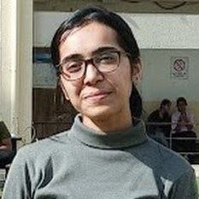

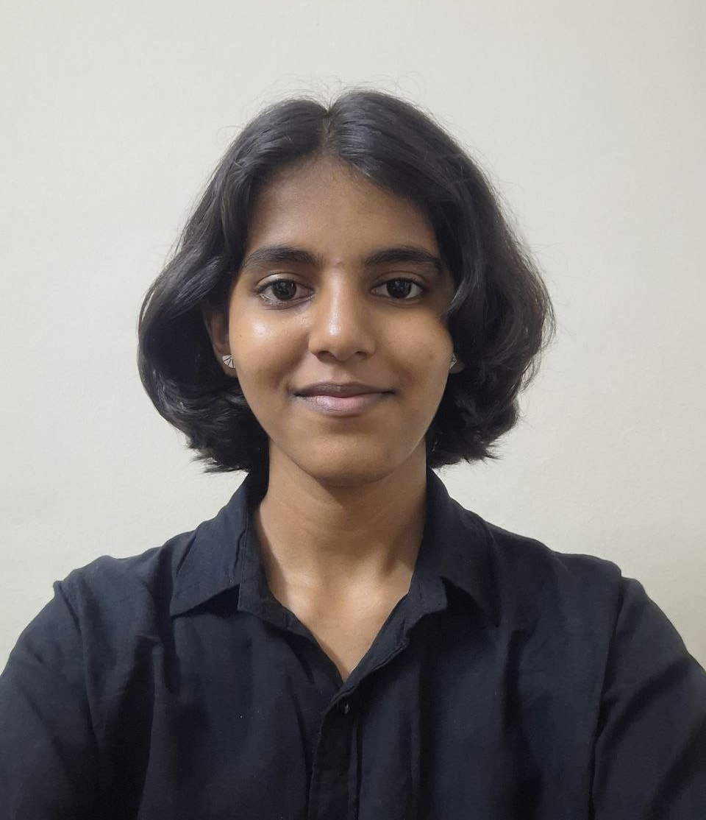
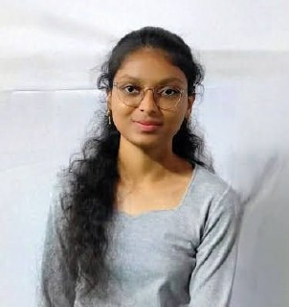
Project Title:- SilverCare: Proactive AI platform for Elderly Assistance, Health Monitoring & Caregiver Support
Puja Nikam, Computer Engineering
Team No. 89
Insert your professional photo
Vishwakarma Institute of Technology, Pune, Maharashtra
Tanvi Nanaware, Computer Engineering
Vaishnavi Narkhede, Computer Engineering

Slide 3
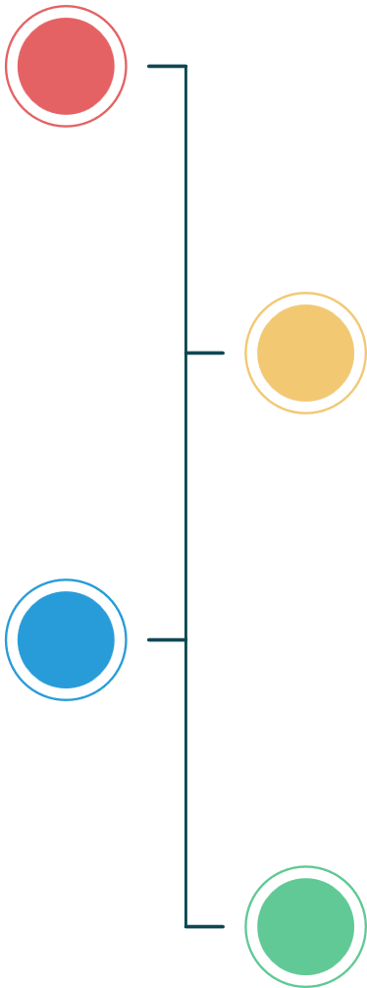







Problem Statement
SilverCare - Automated, Intelligent, and Wearable Monitoring System
The Challenge: With the increasing elderly population, many senior citizens live alone without continuous
supervision, leading to safety risks such as:
Frequent Falls- leading cause of serious health complications.
Delayed Assistance– senior citizens are unable to seek immediate help.
Unnoticed Instability & Prolonged Inactivity – gradual imbalance and abnormal movements go unnoticed also, early warning signs of health issues are missed.
Medication Non-Adherence –elderly individuals often forget to take medicines on time, leading to missed doses.
Without an intelligent and reliable monitoring solution, senior citizens remain vulnerable to preventable injuries and delayed medical intervention

Slide 4
Need of Project
Aspect | Description
Existing Solutions | Basic fall detection devices and emergency buttons; limited monitoring features; no behavioral analysis or predictive insights.
Limitations | High false alerts, lack of real-time tracking, no early risk detection, no medication reminders, and limited caregiver communication.
Need for SilverCare | An intelligent, wearable system with continuous monitoring, early instability detection, fall detection, medication reminders, and automated real-time alerts to caregivers
Impact | Faster emergency response, reduced injury severity, improved elderly safety, and peace of mind for families.

Slide 5
Proposed Solution
Wearable Waistband Device – Comfortable for continuous daily use.
Multi-Sensor Monitoring – Tracks movement, posture, inactivity, and vital signs in real time.
Smart Detection System – Processes data to detect falls and abnormal behaviour with fewer false alerts.
Medicine Reminder Feature – Sends timely alerts to ensure medicines are taken on schedule.
Automatic Emergency Alerts – Notifies caregivers instantly via GSM or Twilio.

Slide 6
Solution Overview
What?
A wearable monitoring system for senior citizens to track health, activity, and safety.
Why? To reduce risks from falls, missed medications, and delayed emergency response.
Who? Elderly individuals living alone and their caregivers or family members.
Where? At home or during daily activities, without restricting movement.
When? Continuous monitoring, with instant alerts during emergencies.
How? Using a wearable waistband with multi-sensors, smart detection logic, medicine reminders, and automatic caregiver alerts.

Slide 7
Technology used
1
Microcontroller: ESP32
2
Motion Sensor: MPU6050 (Accelerometer and Gyroscope)
Physiological Sensors: MAX30102 (Heart Rate and SpO2), DS18B20 (Body Temperature)
3
Machine Learning: Multi-parameter rule-based engineer and Decision Trees
4
5
Communication: Twilio API key, GSM module for alert delivery
5
6
Software Tools: Python, JavaScript, Arduino IDE, Serial Monitor, Firebase.

Slide 8
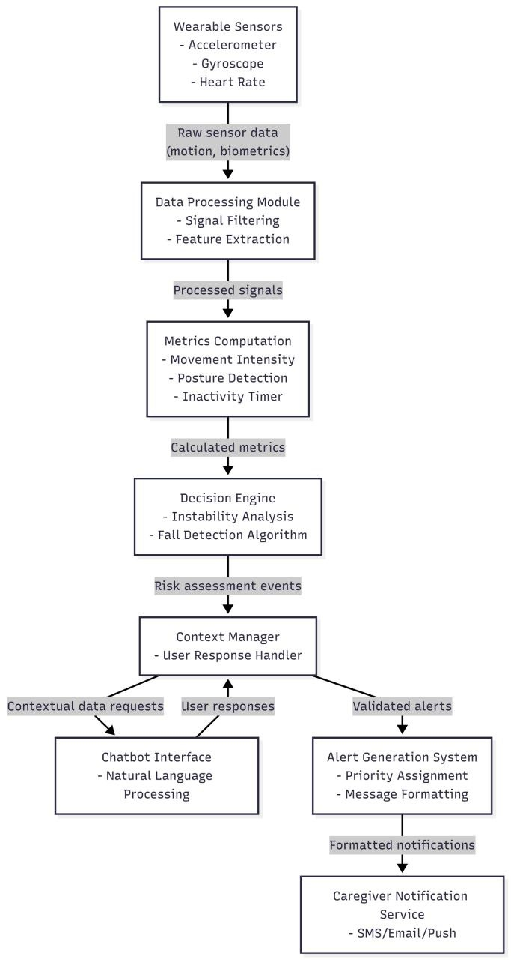
Technical flow diagram -

Slide 9
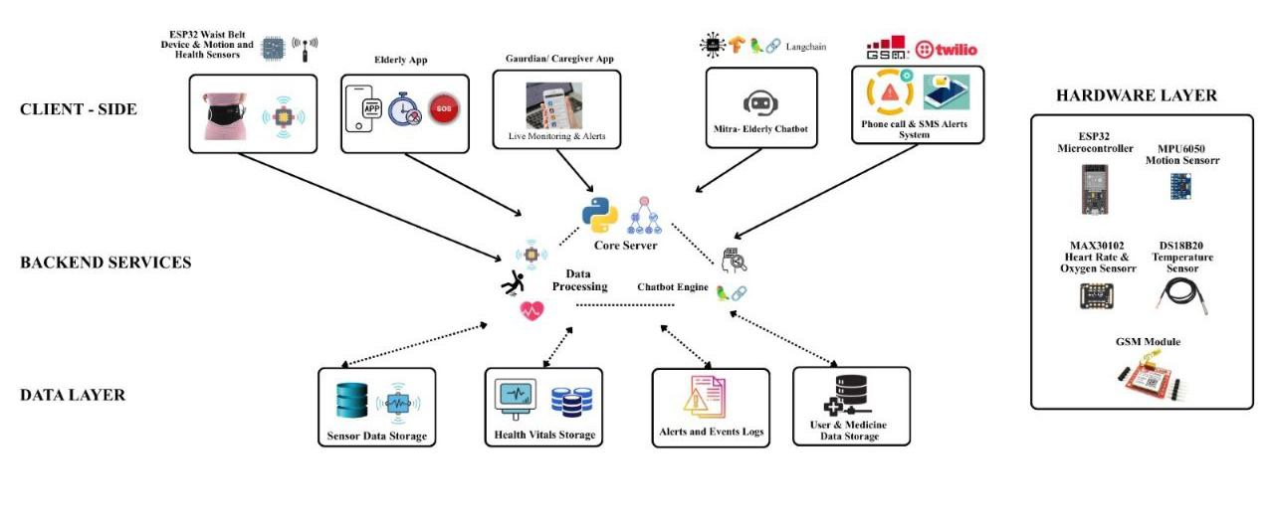
Architecture Blueprint

Slide 10
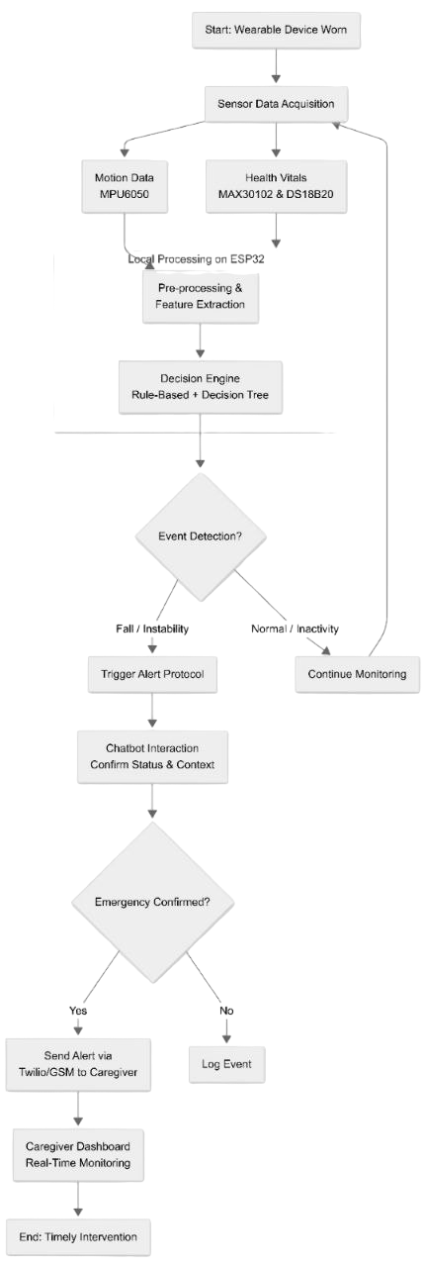
Workflow diagram

Slide 11
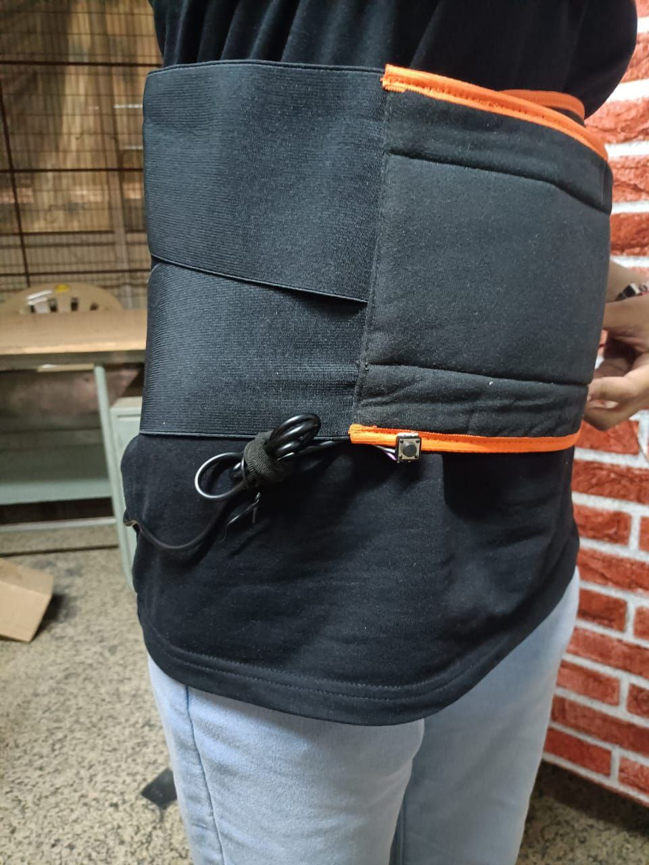
Screen shots of your project -
Wearable Waist Belt (Hardware)

Slide 12
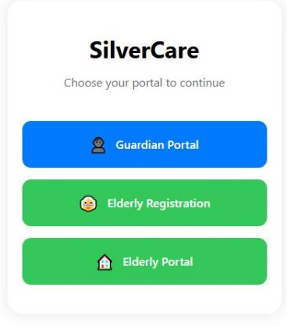
Screen shots of your project -
Home screen

Slide 13
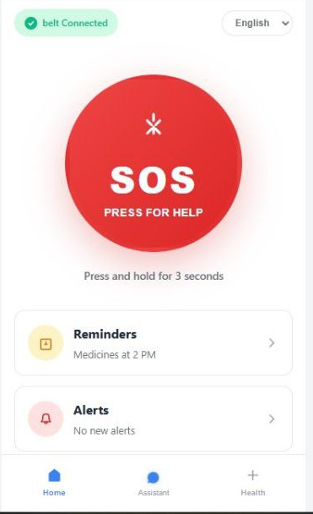
Screen shots of your project -
Elderly Portal

Slide 14
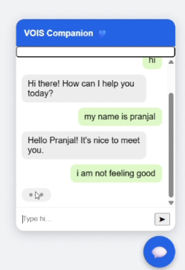
Screen shots of your project -
AI companion chatbot

Slide 15
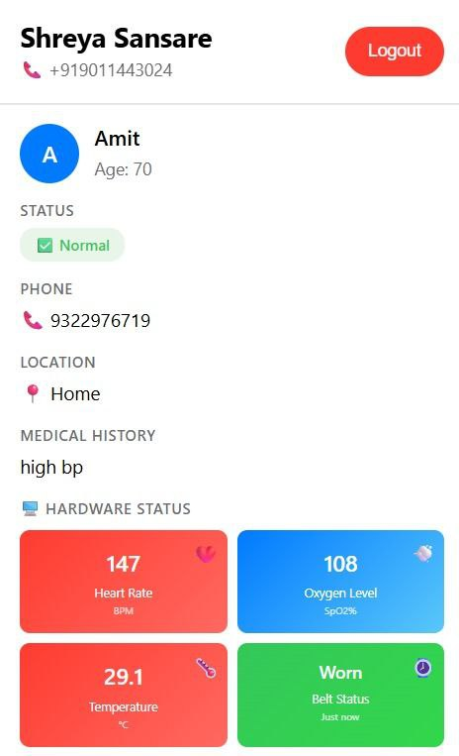
Screen shots of your project -
Guardian Dashboard

Slide 16
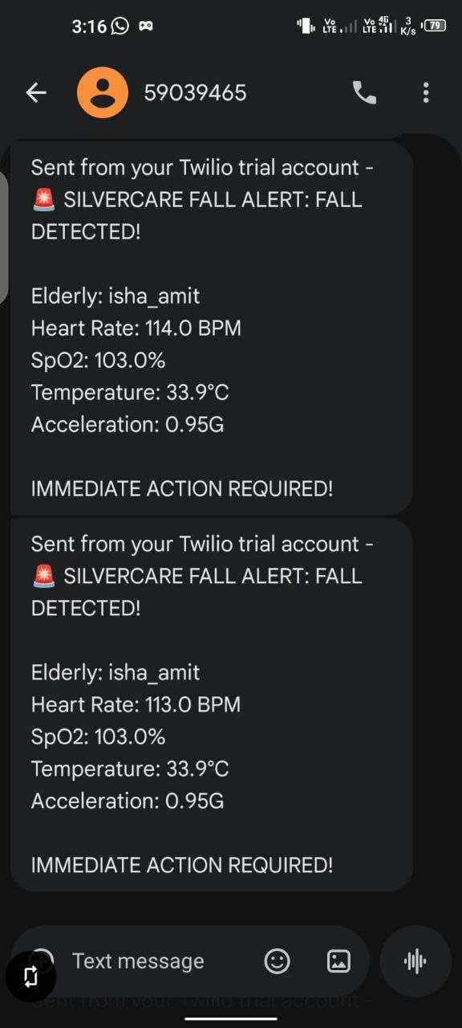
Screen shots of your project -
SMS alert through Twilio

Slide 17
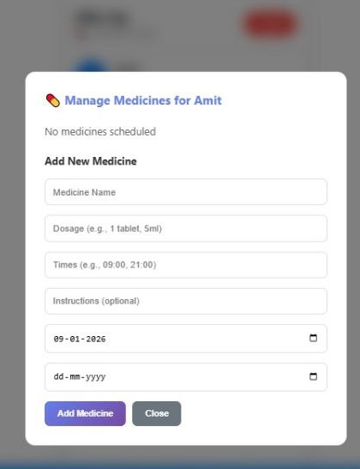
Screen shots of your project -
Medicine Scheduling

Slide 18
Novelty and Uniqueness
1
2
3
4
Proactive Monitoring- Detects abnormal patterns before serious fall.
Wearable waistband and real-time alerts:- Comfortable for daily use and emergency alerts for quick response.
Multi-Sensor Integration:- Combines motion and vital sensors for reliable detection
Built-in Medicine Reminder:- Ensures timely medication along with safety monitoring in a single device.

Slide 19
Git Hub Link
Please test and Paste the working GitHub URL – https://github.com/Pujagithub2006/VOIS-and-Team-89

Slide 20
Future Scope
Advanced Health Sensors: Add improved physiological sensors for early detection.
Better AI models: Train with larger real-world data for higher accuracy.
Emergency System Integration: Connect with emergency services for faster response.

Slide 21
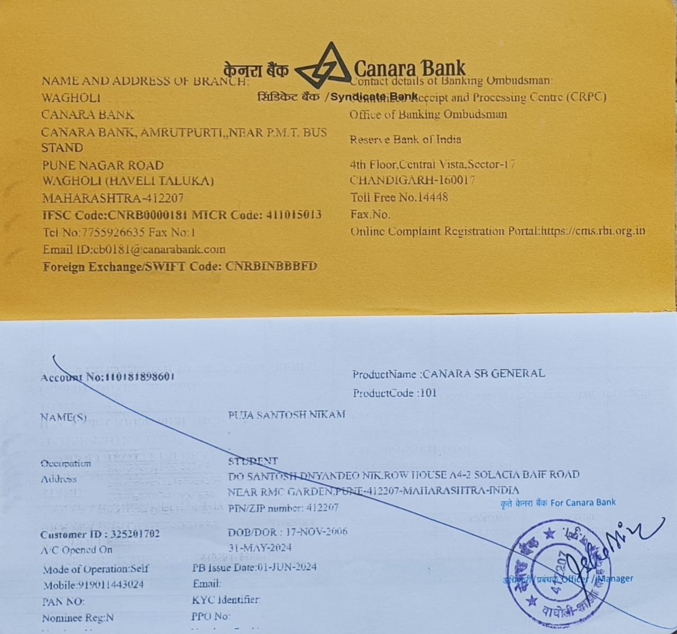
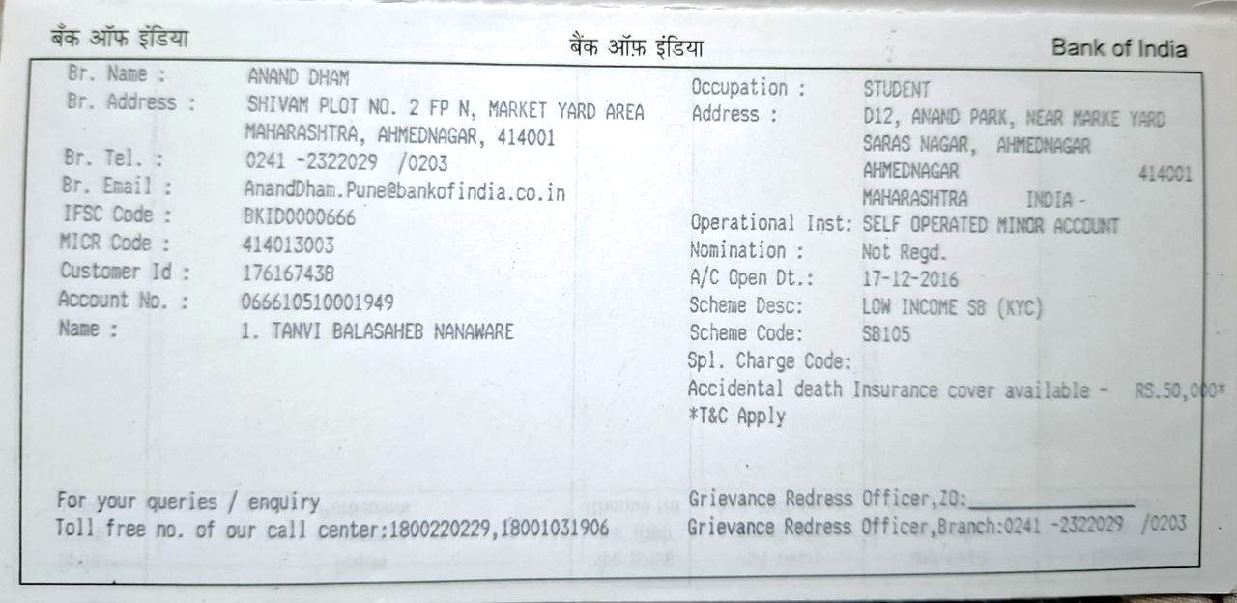
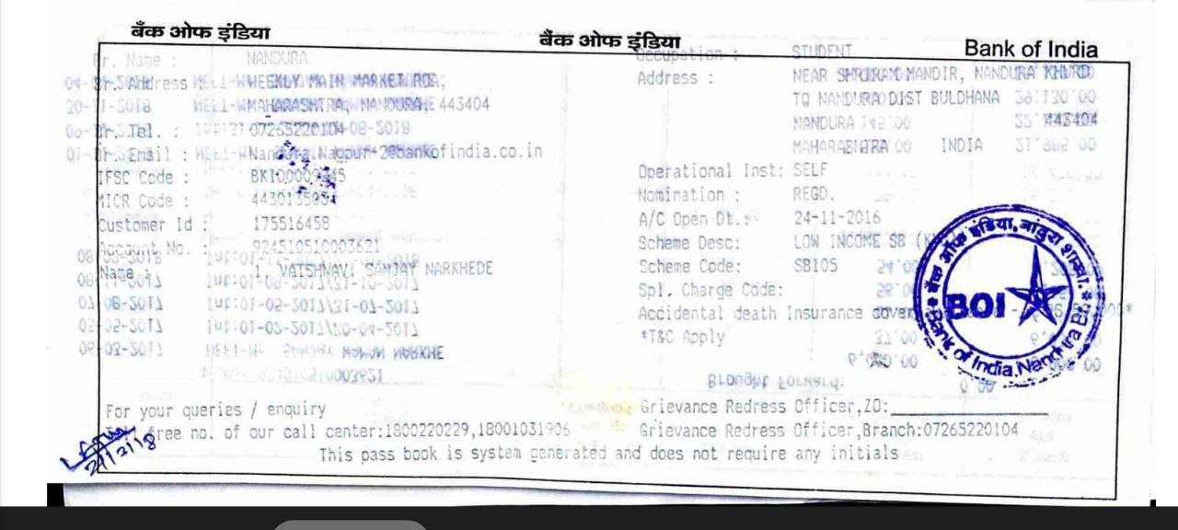
Bank Details
Full Name (as per bank records): | Bank Name | Branch Name | Account Number | Account Type (Savings / Current) | IFSC Code
Puja Santosh Nikam | Canara Bank | Wagholi | 110181898601 | Savings | CNRB0000181
Tanvi Balasaheb Nanaware | Bank Of India | Anand Dham | 066610510001949 | Savings | BKID0000666
Vaishnavi Sanjay Narkhede | Bank Of India | Nandura | 924510510003621 | Savings | BKID0009245
Insert photo of passbook / bank statement
Team Member 1 Passbook/ Bank Statement With Name and Account Number
Team Member 2 Passbook/ Bank Statement With Name and Account Number
Team Member 3 Passbook/ Bank Statement With Name and Account Number

Slide 22
Thank You

